Slide 1
Plate Boundaries

Slide 2
By the end of this lesson, you will be able to:
Outline the primary forces driving the motion of tectonic plates.
Distinguish between the three types of plate boundaries: divergent, convergent and transform plate boundaries.
Understand how common geological and seismic features found in each plate boundary are caused.
Identify real world examples of plate boundaries.

Slide 3
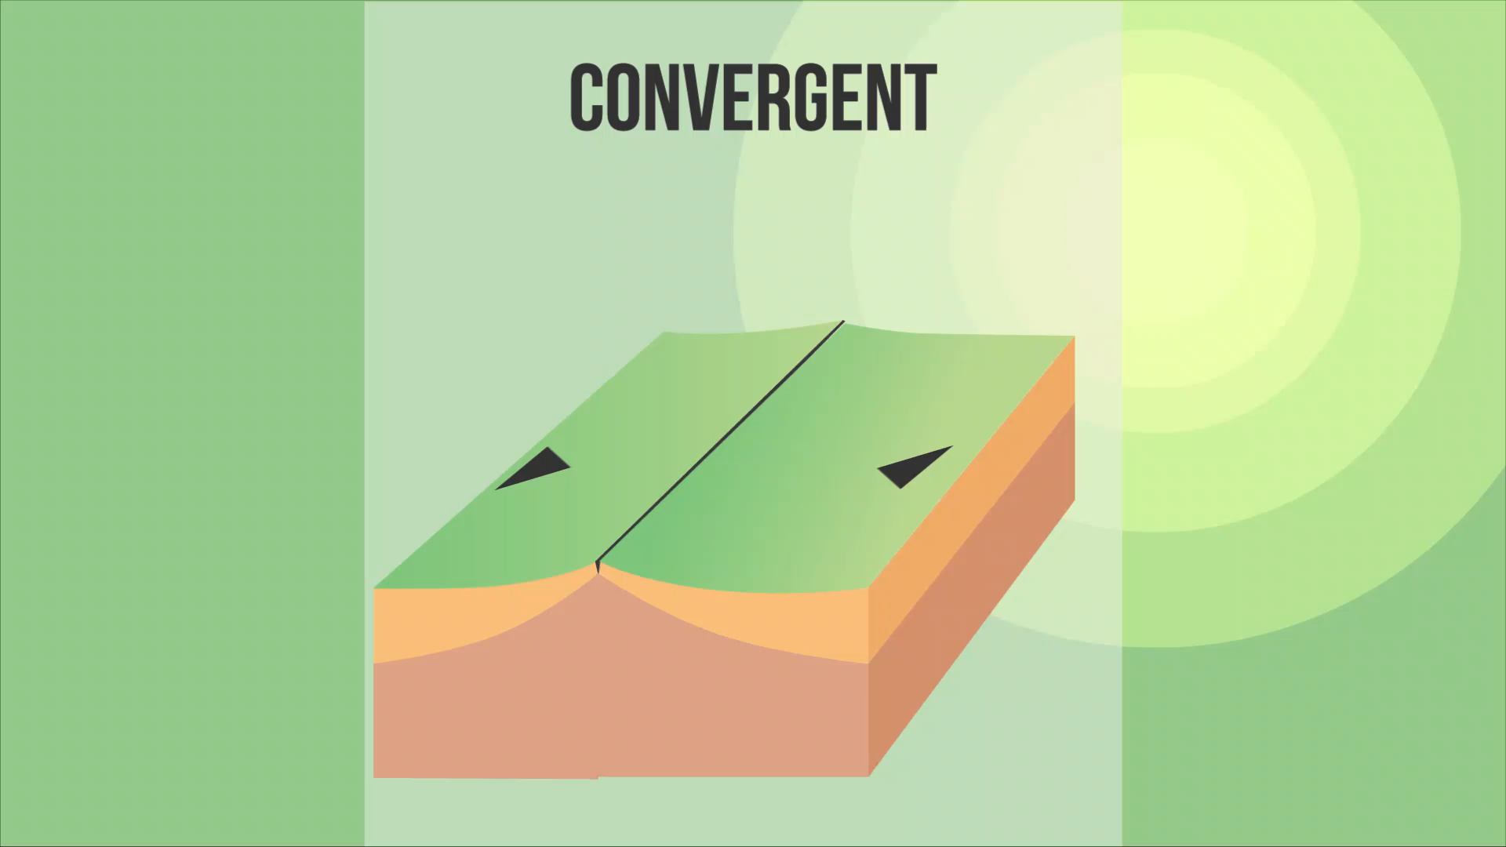
A type of motion you might have thought of was the collision of two tectonic plates.
We call these convergent plate boundaries because the two plates have come together. This can happen between oceanic and continental crust, or between two continental crusts. The animation below shows two continental crusts colliding!

Slide 4
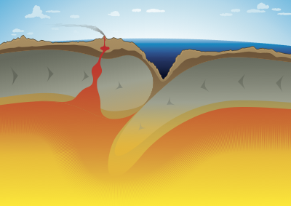
So what happens when oceanic crust meets continental crust?
We call these boundaries subduction zones. Remember how dense the oceanic crust is? Denser objects always sink, so when these two crusts collide, the oceanic crust sinks, or subducts, underneath the continental crust. It enters the asthenosphere.

Slide 5
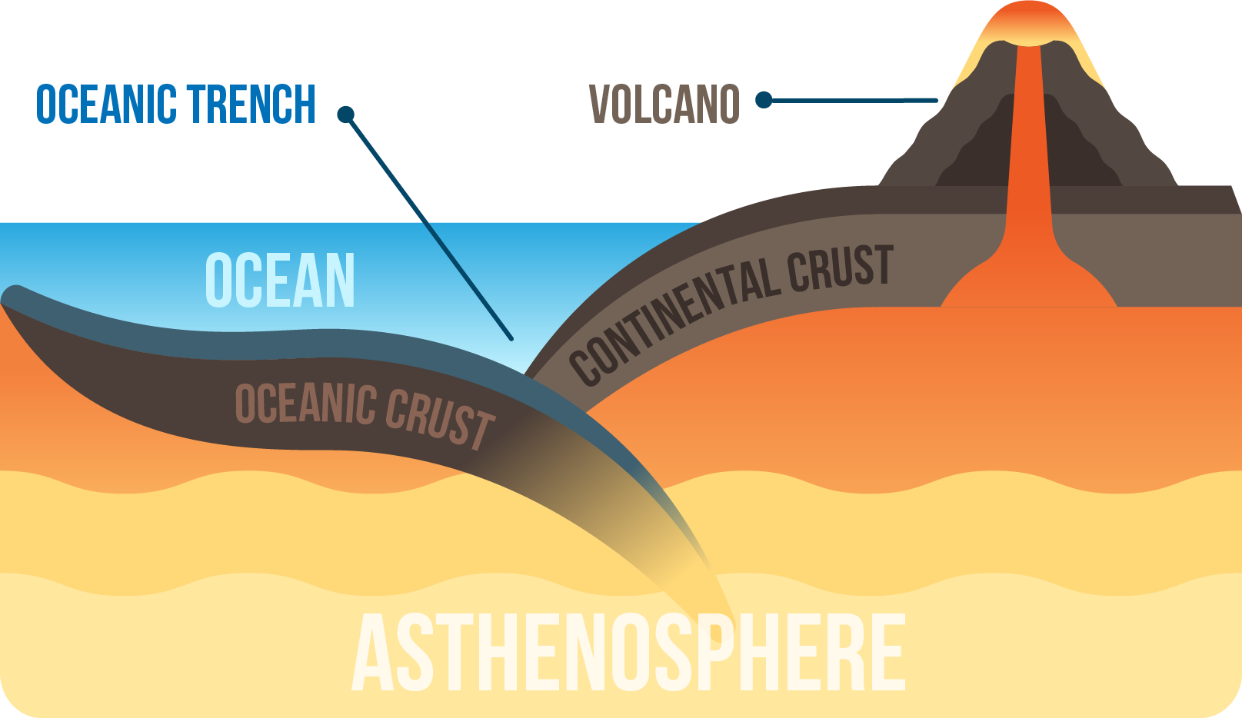
Some of the molten rock rises and penetrates the overlying continental crust, creating volcanoes. Back at the point of collision, deep trenches are formed along the ocean floor.
Because subduction zones cause oceanic crust to melt, they are considered to be destructive.

Slide 6
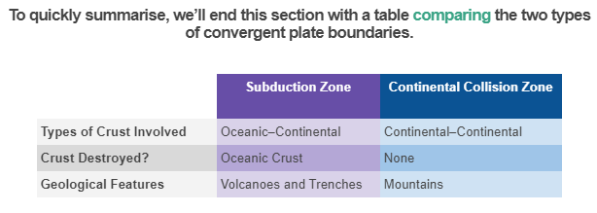

Slide 7
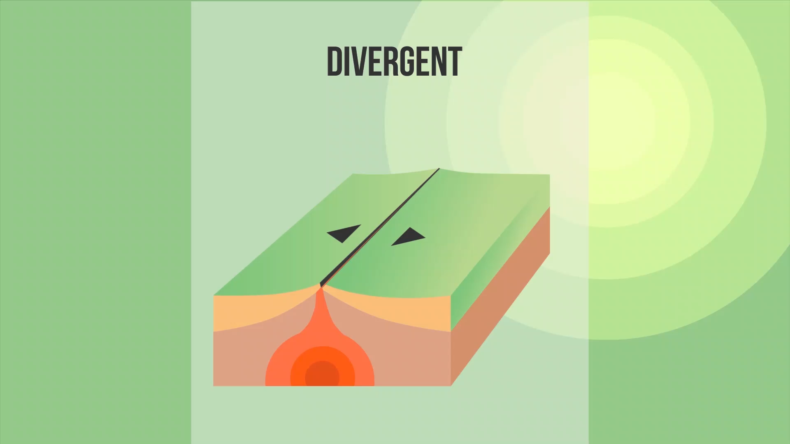
Tectonic plates can come together, but they can also drift apart.
Sometimes, the convection current causes plates to separate, creating a gap. Hot rocks from the asthenosphere rises to fill this gap, propelled by the convection current. Watch the animation below to get an idea of what it looks like!

Slide 8
In the ocean, divergent plate boundaries form mid-ocean ridges.
The rising rock quickly cools and solidifies when it comes into contact with water. This creates new oceanic crust, so this process is sometimes considered to be constructive. Younger rock is always located closer to the ridge, while older rock is found further away.
We call the entire process (where new ocean crust is built) seafloor spreading.

Slide 9
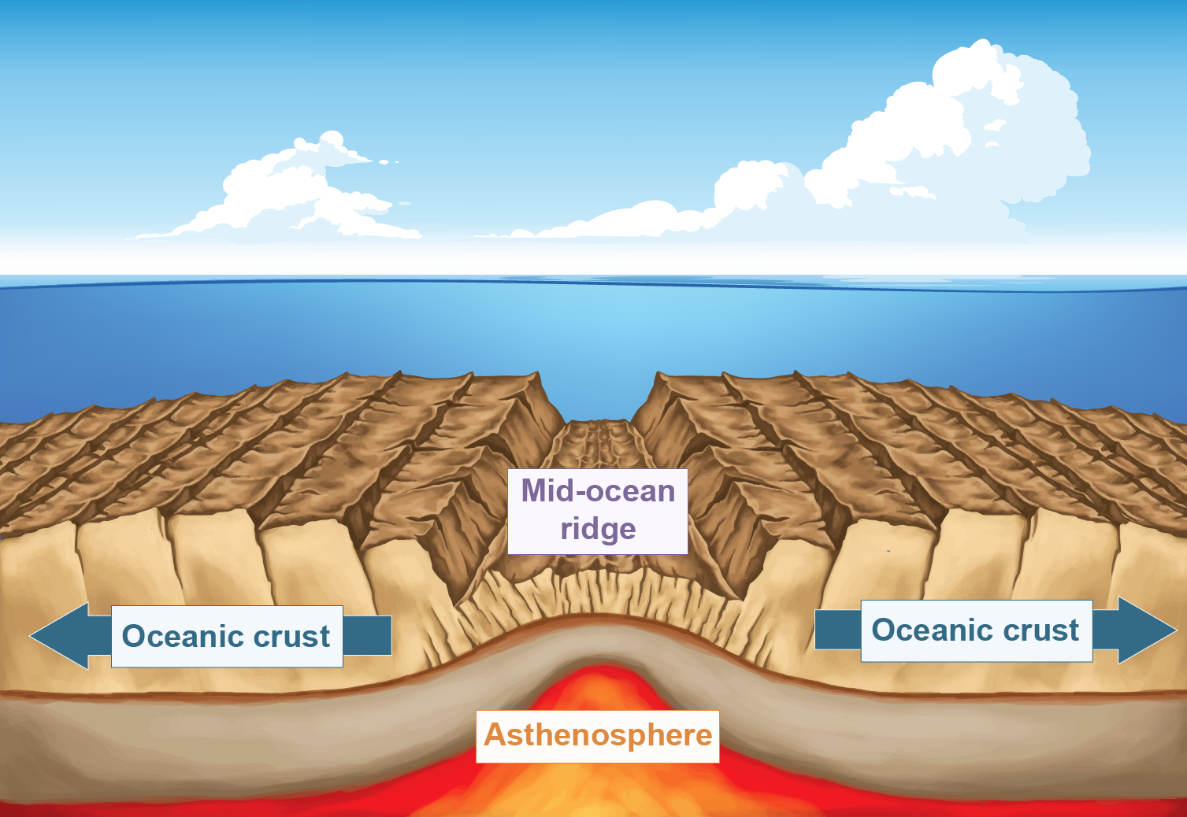

Slide 10
On land, the continental crust is so thick that the plates don’t break cleanly.
Instead, the crust slowly stretches and thins out in a process called rifting. This causes great cracks to appear.
Once the land sinks below sea level, ocean water seeps in and fills the gap. Eventually, the crust thins enough that hot rocks from the asthenosphere can punch through, producing volcanoes.

Slide 11
How can tectonic plates move without coming together or apart?
There’s one more motion we haven’t considered yet: tectonic plates can grind past each other. Watch the animation below to get an idea of what it looks like!
The crust is neither destroyed nor created here, so we sometimes call a transform plate boundary a conservative boundary.

Slide 12
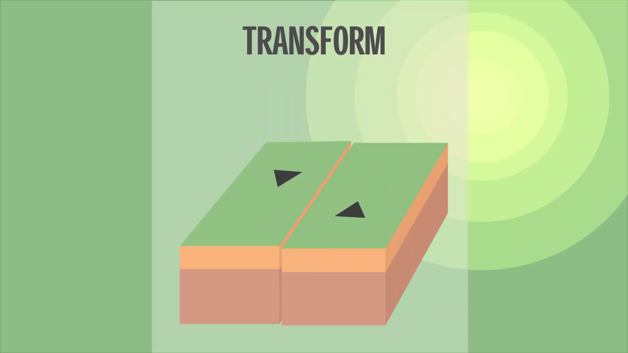

Slide 13
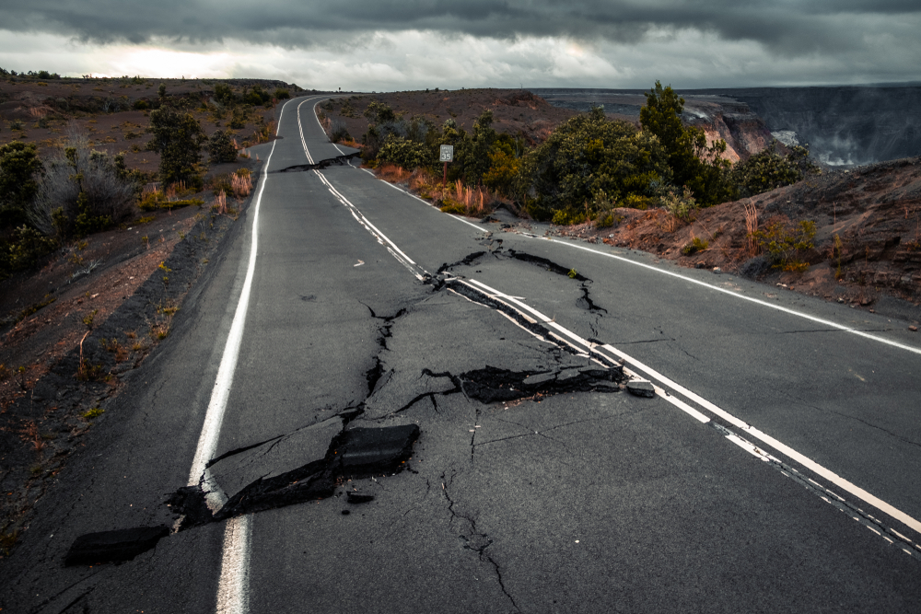
Although you may not see transform plate boundaries very well, you can certainly feel them.
If the plates aren’t able to move past each other easily, this builds up a lot of pressure. The energy from that pressure can then be released in an earthquake.

